Slide 1
Classification (Decision Tree)
Data Mining* (CSC521)
*The instructor thanks Dr Jae-Gil Lee for sharing the lecture slides.

Slide 2
Contents
Basic Concepts
Decision Tree Induction
GINI Index (CART)
Information Gain / Gain Ratio (ID3, C4.5)

Slide 3

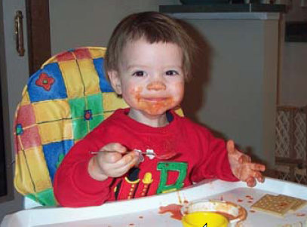
Entropy
Low Entropy
High Entropy
the values (locations of soup) sampled entirely from within the soup bowl
the values (locations of soup) unpredictable... almost uniformly sampled throughout our dining room
From Prof. Moore’s tutorial: http://www.autonlab.org/tutorials/infogain11.pdf

Slide 4
Alternative Splitting Criteria Based on INFO
Entropy at a given node t:
(NOTE: p( j | t) is the relative frequency of class j at node t)
Measures homogeneity of a node
Maximum (log n_{c}) when records are equally distributed among all classes, implying least information
Minimum (0.0) when all records belong to one class, implying most information
Entropy based computations are similar to the GINI index computations

Slide 5
Examples for Computing Entropy
P(C1) = 0/6 = 0 P(C2) = 6/6 = 1
Entropy = – 0 log₂ 0 – 1 log₂ 1 = – 0 – 0 = 0
P(C1) = 1/6 P(C2) = 5/6
Entropy = – (1/6) log₂ (1/6) – (5/6) log₂ (5/6) = 0.65
P(C1) = 2/6 P(C2) = 4/6
Entropy = – (2/6) log₂ (2/6) – (4/6) log₂ (4/6) = 0.92

Slide 6
Information Gain
Parent Node p is split into k partitions;
n_{i} is number of records in partition i
Measures the reduction in the entropy caused by the split; choose the split that achieves most reduction (maximizes GAIN)
Used in ID3
Disadvantage: tends to prefer splits that result in large number of partitions, each being small but pure

Slide 7
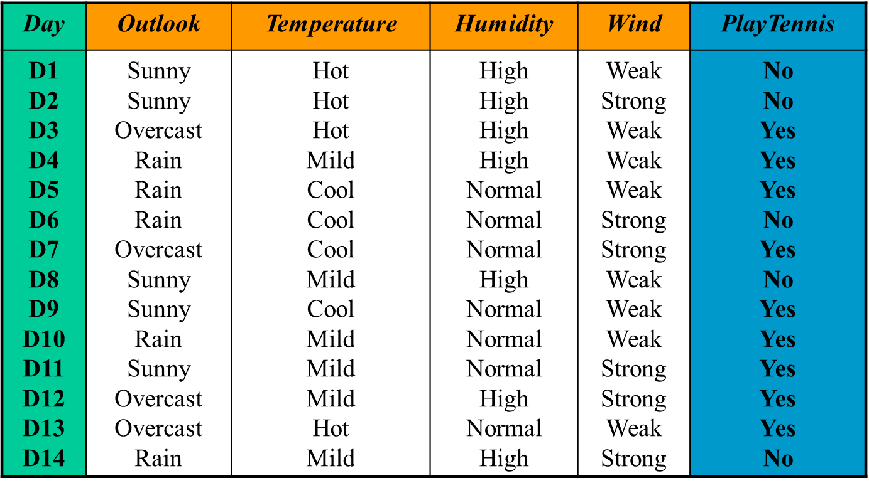
Play Tennis Example (1/15)

Slide 8
Play Tennis Example (2/15)
Final decision tree by ID3
Outlook
Sunny
Overcast
Rain
Humidity
YES
Wind
High
Normal
Strong
Weak
NO
YES
NO
YES

Slide 9
Play Tennis Example (3/15)
Entropy D

Slide 10
Play Tennis Example (4/15)
[9+,5-] : E = 0.940
Wind
Weak
Strong
Attribute Wind
D = [9+,5-]
D_{weak} = [6+,2-]
D_{strong}=[3+,3-]
[6+,2-] : E = 0.811
[3+,3-] : E = 1.0

Slide 11
Play Tennis Example (5/15)
[9+,5-] : E = 0.940
Attribute Humidity
D_{high} = [3+,4-]
D_{normal}=[6+,1-]
Humidity
High
Normal
[3+,4-] : E = 0.985
[6+,1-] : E = 0.592
∑
|
Dv
|
Gain
=
−
(
D
,
Hum
)
Entropy
(
D
)
Entropy
(
Dv
)
∈
|
D
|
v
{
high
,
normal
}
=
−
7
−
7
Entropy
(
D
)
Entropy
(
D
)
Entropy
(
D
)
14
high
14
normal
=
−
7
−
7
0
.
940
0
.
985
0
.
592
14
14
=
0
.
151

Slide 12
Play Tennis Example (6/15)
S=[9+,5-]
E=0.940
Attribute Outlook
Outlook
Over
cast
Sunny
Rain
[2+, 3-]
[4+, 0]
[3+, 2-]
E=0.971
E=0.0
E=0.971
Gain(S,Outlook)
=0.940-(5/14)*0.971-(4/14)*0.0 – (5/14)*0.971
=0.246

Slide 13
Play Tennis Example (7/15)
Best split
Gain(D, Outlook) = 0.246
Gain(D, Humidity) = 0.151
Gain(D, Wind) = 0.048
Gain(D, Temperature) = 0.029
[9+,5-] : E = 0.940
Outlook
Sunny
Rain
Overcast
[2+,3-] : (D1, D2, D8, D9, D11)
[4+,0-] : (D3, D7, D12, D13)
YES
[3+,2-] : (D4, D5, D6, D10, D14)

Slide 14
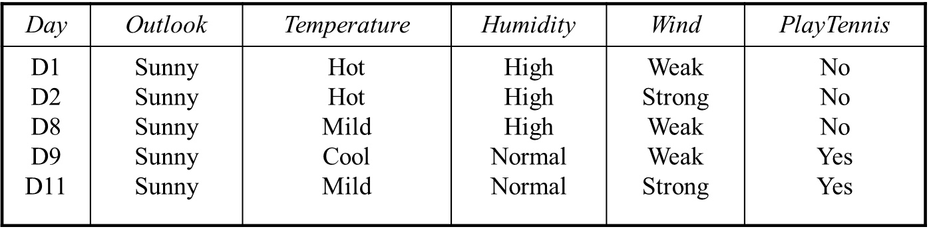
Play Tennis Example (8/15)
Entropy D_{sunny}

Slide 15
Play Tennis Example (9/15)
[2+,3-] : E = 0.971
Wind
Weak
Strong
Attribute Wind
D_{weak} = [1+,2-]
D_{strong}=[1+,1-]
[1+,2-] : E = 0.918
[1+,1-] : E = 1.0

Slide 16
Play Tennis Example (10/15)
[2+,3-] : E = 0.971
Humidity
High
Normal
Attribute Humidity
D_{high} = [0+,3-]
D_{normal}=[2+,0-]
[0+,3-] : E = 0.00
[2+,0-] : E = 0.00

Slide 17
Play Tennis Example (11/15)
Best split
Gain(D, Humidity) = 0.971
Gain(D, Wind) = 0.020
Gain(D, Temperature) = 0.571
[9+,5-] : E = 0.940
Outlook
Sunny
Overcast
Rain
Humidity
YES
[3+,2-] : (D4, D5, D6, D10, D14)
High
Normal
NO
YES

Slide 18
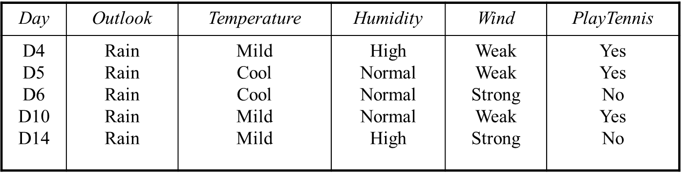
Play Tennis Example (12/15)
D_{rain}
Entropy D_{rain}

Slide 19
Play Tennis Example (13/15)
Attribute Wind
D_{weak} = [3+,0-]
D_{strong}=[0+,2-]
[3+,2-] : E = 0.971
Wind
Weak
Strong
[3+,0-] : E = 0.00
[0+,2-] : E = 0.00

Slide 20
Play Tennis Example (14/15)
[2+,3-] : E = 0.971
Attribute Humidity
D_{high} = [1+,1-]
D_{normal}=[2+,1-]
Humidity
High
Normal
[1+,1-] : E = 1.00
[2+,1-] : E = 0.918

Slide 21
Play Tennis Example (15/15)
Best split
Gain(D, Humidity) = 0.020
Gain(D, Wind) = 0.971
Gain(D, Temperature) = 0.020
Outlook
Sunny
Overcast
Rain
Humidity
YES
Wind
High
Normal
Strong
Weak
NO
YES
NO
YES

Slide 22
Thank You!
Questions?

